Slide 1
Problem Statement #4
Objective:
Implement a student’s attendance in monitoring system using Face Recognition /Radio Frequency Identification Tags etc. The system should automatically mark and notify the attendance of the students to the respective stakeholders of the organization.

Slide 2
Team Name: THE PROSITRONS
TEAM LEADER:
NANTHAKRISHNA V .T
TEAM MEMBERS:
HARINI K.B
PRADHEEKSHA A.S
RAM BALAJI OLYMIA T.S
PRASANNA KUMAR M.M
SAMUEL JEBADURAI J

Slide 3
TECHNOLOGIES USED:
PYTHON
FACE RECOGNITION
TWILIO
ARTIFICIAL INTELLIGENCE

Slide 4
OBJECT DETECTION(CODE)
import cv2
import os
dataset = "dataset"
name = "RAM"
path = os.path.join(dataset,name)
if not os.path.isdir(path):
os.mkdir(path)
(width,height) = (130,100)
alg = "haarcascade_frontalface_default.xml"
haar_cascade = cv2.CascadeClassifier(alg)
cam = cv2.VideoCapture(0)
count = 1
while count < 31:
print(count)
_,img = cam.read()
grayImg = cv2.cvtColor(img,cv2.COLOR_BGR2GRAY)
face = haar_cascade.detectMultiScale(grayImg,1.3,4)
for (x,y,w,h) in face:
cv2.rectangle(img,(x,y),(x+w,y+h), (0,255,0),2)
faceOnly = grayImg[y:y+h,x:x+w]
resizeImg = cv2.resize(faceOnly,(width,height))
cv2.imwrite("%s/%s.jpg" %(path,count),resizeImg)
count+=1
cv2.imshow("FaceDetection",img)
key = cv2.waitKey(10)
if key == 27:
break
print("Image Captured succssfully")
cam.release()
cv2.destroyAllWindows()

Slide 5
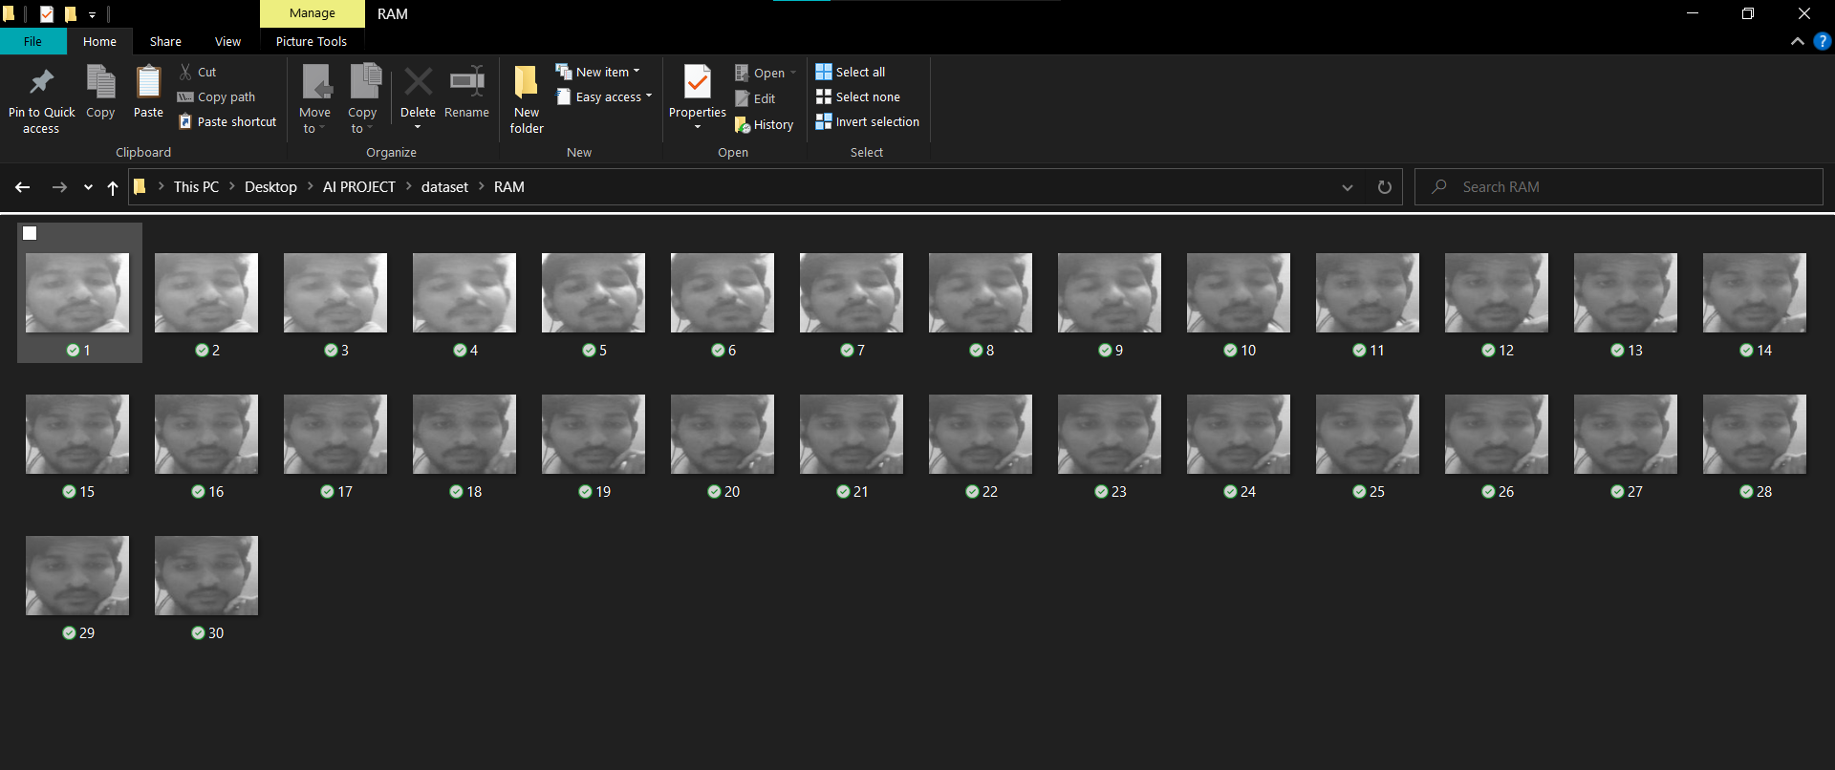
DATASETS

Slide 6
OBJECT RECOGNITION(CODE)
import cv2, numpy, os
haar_file = 'haarcascade_frontalface_default.xml'
face_cascade = cv2.CascadeClassifier(haar_file)
datasets = 'dataset'
print('Training...')
(images, labels, names, id) = ([], [], {}, 0)
for (subdirs, dirs, files) in os.walk(datasets):
for subdir in dirs:
names[id] = subdir
subjectpath = os.path.join(datasets, subdir)
for filename in os.listdir(subjectpath):
path = subjectpath + '/' + filename
label = id
images.append(cv2.imread(path, 0))
labels.append(int(label))
id +=1
(images, labels) = [numpy.array(lis) for lis in [images, labels]]
print(images, labels)
(width, height) = (130, 100)
model = cv2.face.LBPHFaceRecognizer_create()
#model = cv2.face.FisherFaceRecognizer_create()
model.train(images, labels)
webcam = cv2.VideoCapture(0)
cnt=0
while True:
(_, im) = webcam.read()
gray = cv2.cvtColor(im, cv2.COLOR_BGR2GRAY)
faces = face_cascade.detectMultiScale(gray, 1.3, 5)
for (x,y,w,h) in faces:
cv2.rectangle(im,(x,y),(x+w,y+h),(255,255,0),2)
face = gray[y:y + h, x:x + w]
face_resize = cv2.resize(face, (width, height))
prediction = model.predict(face_resize)
cv2.rectangle(im, (x, y), (x + w, y + h), (0, 255, 0), 3)
if prediction[1]<800:
cv2.putText(im,'%s - %.0f' % (names[prediction[0]],prediction[1]),(x-10, y-10), cv2.FONT_HERSHEY_PLAIN,2,(0, 0, 255))
print (names[prediction[0]])
cnt=0
else:
cnt+=1
cv2.putText(im,'Unknown',(x-10, y-10), cv2.FONT_HERSHEY_PLAIN,1,(0, 255, 0))
if(cnt>100):
print("Unknown Person")
cv2.imwrite("unKnown.jpg",im)
cnt=0
cv2.imshow('FaceRecognition', im)
key = cv2.waitKey(10)
if key == 27:
break
webcam.release()
cv2.destroyAllWindows()

Slide 7
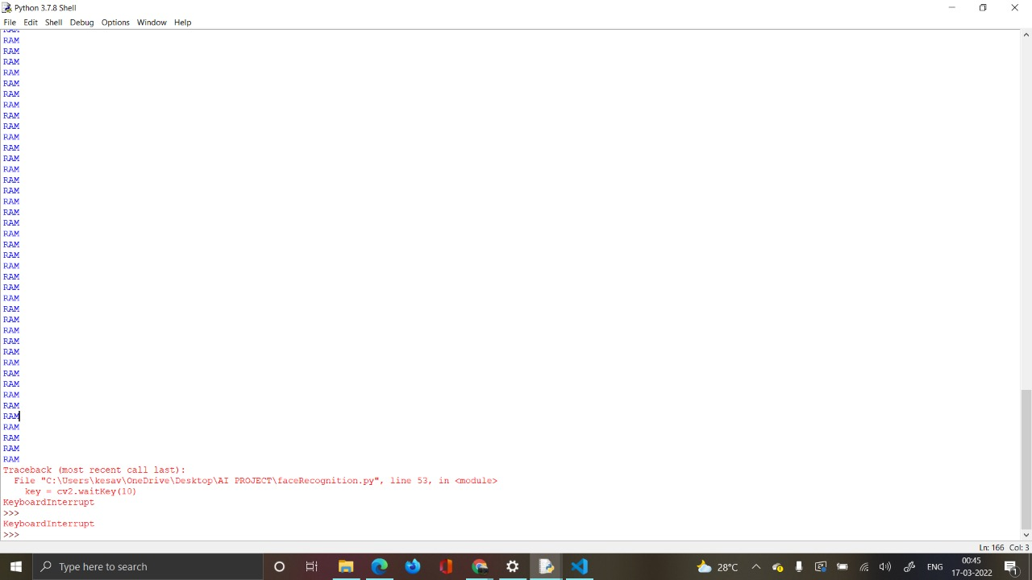
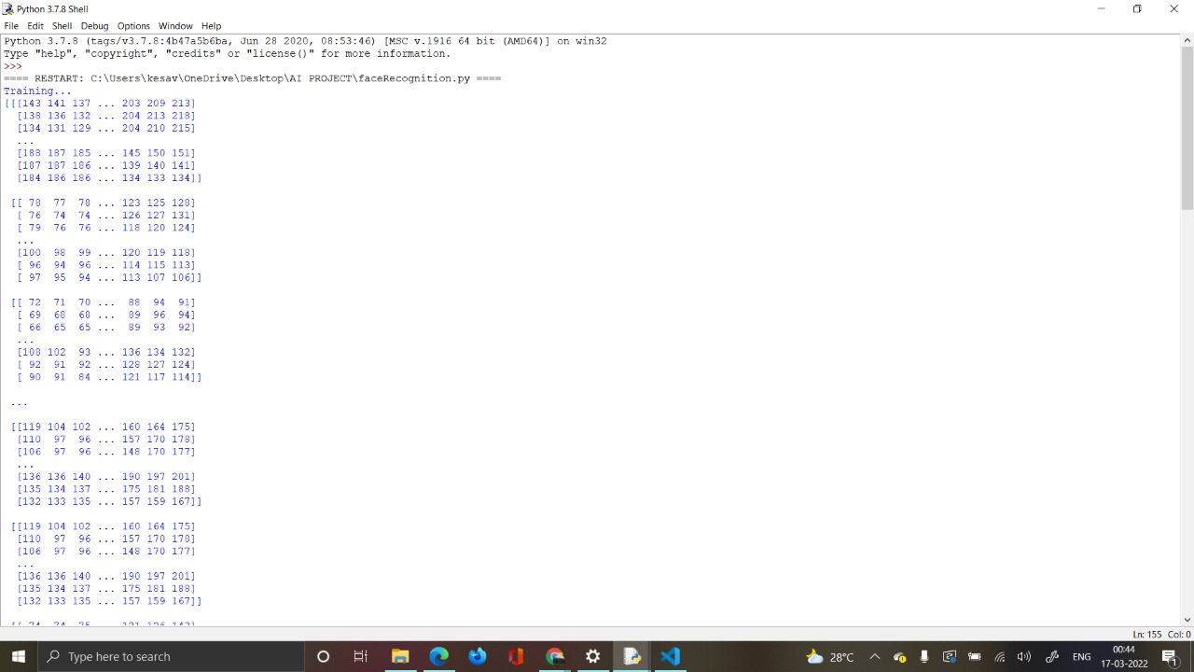
OUTPUT

Slide 8
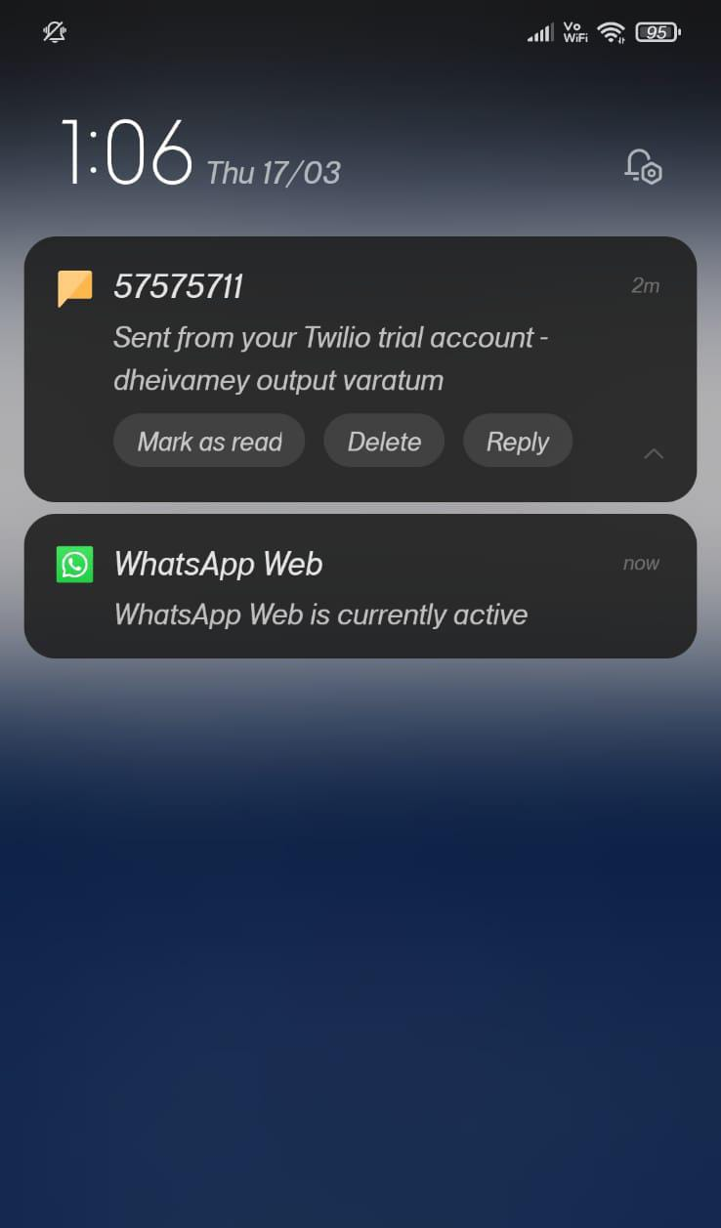
TWILIO(API)
Twilio offers complete solutions to building communication with telephony.
More than a million developers and leading brands are already using Twilio to build innovative communications solutions.
Twilio Communications APIs enable voice, messaging, and video conversations within the web and mobile apps.
This facilitates developers to make easy communications between different apps.

Slide 9
TWILIO(CODE)
from twilio.rest import Client
from datetime import datetime
now = datetime.now()
current_time = now.strftime("%H:%M:%S")
# Your Account SID from twilio.com/console
account_sid = "AC51902da0eb1d0ce458a1b9ddf58f7015"
# Your Auth Token from twilio.com/console
auth_token = "925e392cdf76daa7b6b8dea02d6acda6"
client = Client(account_sid, auth_token)
message = client.messages.create(
to="+919597302419",
from_="+15865542681",
body= current_time)
print(message.sid)

